Slide 1
Observing climate change trends in ocean biogeochemistry:
When and where
Stephanie Henson
Claudie Beaulieu, Richard Lampitt
s.henson@noc.ac.uk
Notes:
Observing CC trends and expected changes

Slide 2
How do we expect the oceans to respond to climate change?
Temperature
pH
Oxygen
Primary production
Carbon flux
?

Slide 3
Importance of detecting climate change response
400
300
Atmospheric pCO₂
(ppm)
1 in 7 of the world’s population rely on the ocean for their primary protein source
FAO (2012)
200
shallow
deep
Remineralisation depth
of organic carbon
After Kwon et al. (2009), Nature Geo
Notes:
Just 2 examples: food availability and cliamte regulation
That’s part of the reason we undertake sustained observations of the ocean

Slide 4
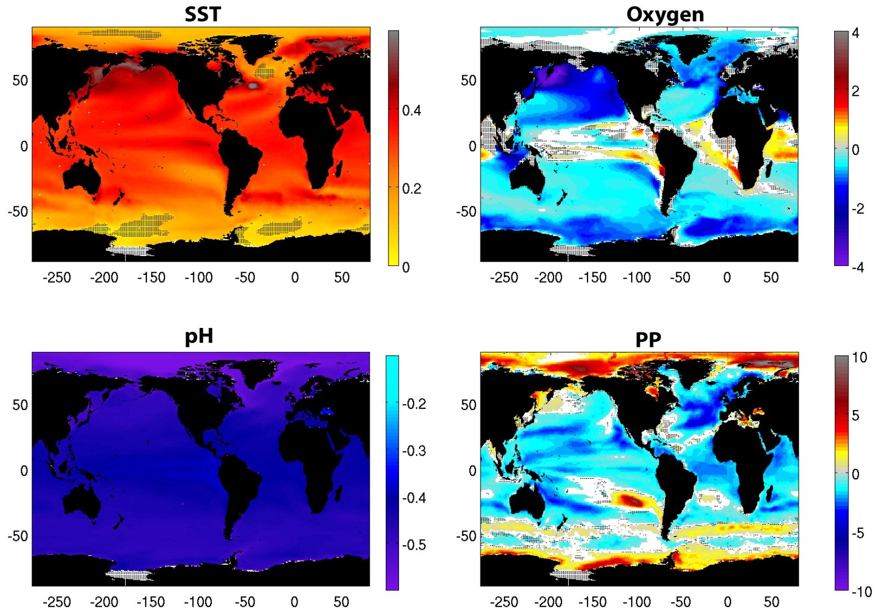
Trends in climate change models
Trend between 2006 and 2100 for RCP8.5. Sea surface temperature (°C/decade); PP, pH and interior oxygen content, all expressed as % change per decade with respect to the mean of 1986-2005. White areas: regression is not statistically significant (p>0.05). Stippling: inter-model agreement is weak

Slide 5
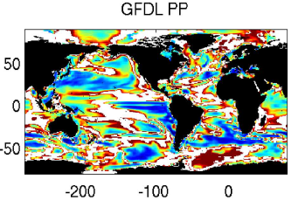
Can we detect these changes?
On average, we need ~ 30-40 years of continuous primary production data to detect a climate change-trend. Why so long?
Henson et al. (2010), Biogeosciences

Slide 6
Large natural variability
Annual mean PP from GFDL ESM
Thick line - warming run, Thin line - control run, Dashed line - standard deviation of control run
Notes:
Role of natural variability in assessing climate change
Masks long-term trends
systems are adapted to range of natural variability

Slide 7
Questions
Can climate change signals be detected more rapidly in other biogeochemical variables?
How long for, and where, should we make observations if we want to detect climate change effects?
And how does all this relate to our current observing capabilities?

Slide 8
The 10 Commandments of Climate Monitoring
Thou shalt not change instruments, sampling rates, locations etc. without a period of overlap
Thou shalt document all data processing algorithms in detail
Thou shalt document all instrument, station and platform history to aid interpretation
Thou shalt not stop observations, resulting in an interrupted record
Thou shalt ensure sufficient calibration, validation and maintenance
Thou shalt safeguard against operational failures
Thou shalt give highest priority to data poor regions, regions sensitive to change, and variables with inadequate spatial and temporal resolution
Thou shalt provide network designers with long-term climate requirements at the outset
Thou shalt not start new time series without a commitment to long-term monitoring
Thou shalt put in place data management systems that make it easy to access, use and interpret the data
Karl (1995), Climatic Change
Notes:
Red particularly appropriate to this study. To address this

Slide 9
Model output
Chosen variables are:
SST, pH, PP, surface chl, export, non-diatom PP, thermocline oxygen, surface nitrate
Output from 8 IPCC models using the RCP8.5 and control runs
Calculate time and space scales needed to observe trend
Notes:
CMIP5 archive
Variables selected because sufficient number of models have that output

Slide 10
How much data is needed to detect a climate change trend?
Signal (i.e. trend) has to exceed noise (i.e. natural variability)
n* : number of years required to detect trend
σ_{N} : standard deviation of the noise (residuals after trend removed)
: estimated trend
: auto-correlation of the noise (AR(1))
Weatherhead et al. (1998)
Notes:
Variable called n*: number of years of data needed to distinguish a trend from natural variability

Slide 11
n* results
SST
PP
Number of years to detect a trend in SST and PP
For SST, ~ 8 – 30 years
For PP, ~ 20 – >50 years
years

Slide 12
n* results
 | MAX | MEDIAN (YRS) | MIN
pH | 5 | 14 | 32
SST | 8 | 16 | 56
oxygen | 11 | 26 | 77
nitrate | 11 | 30 | 58
non-diatom PP | 14 | 31 | 58
chl | 14 | 32 | 57
export | 14 | 32 | 58
PP | 13 | 32 | 59
Equatorial Atlantic, Benguela, Arabian Sea tend to be places with most rapidly detectable trends
Longest timescales in parts of the Southern Ocean, Northeast Pacific
Notes:
pH v. Fast – chemistry
SST fast
Further you get from the physics, the longer it takes, although there are some places of rapid detection even in chl/PP etc.

Slide 13
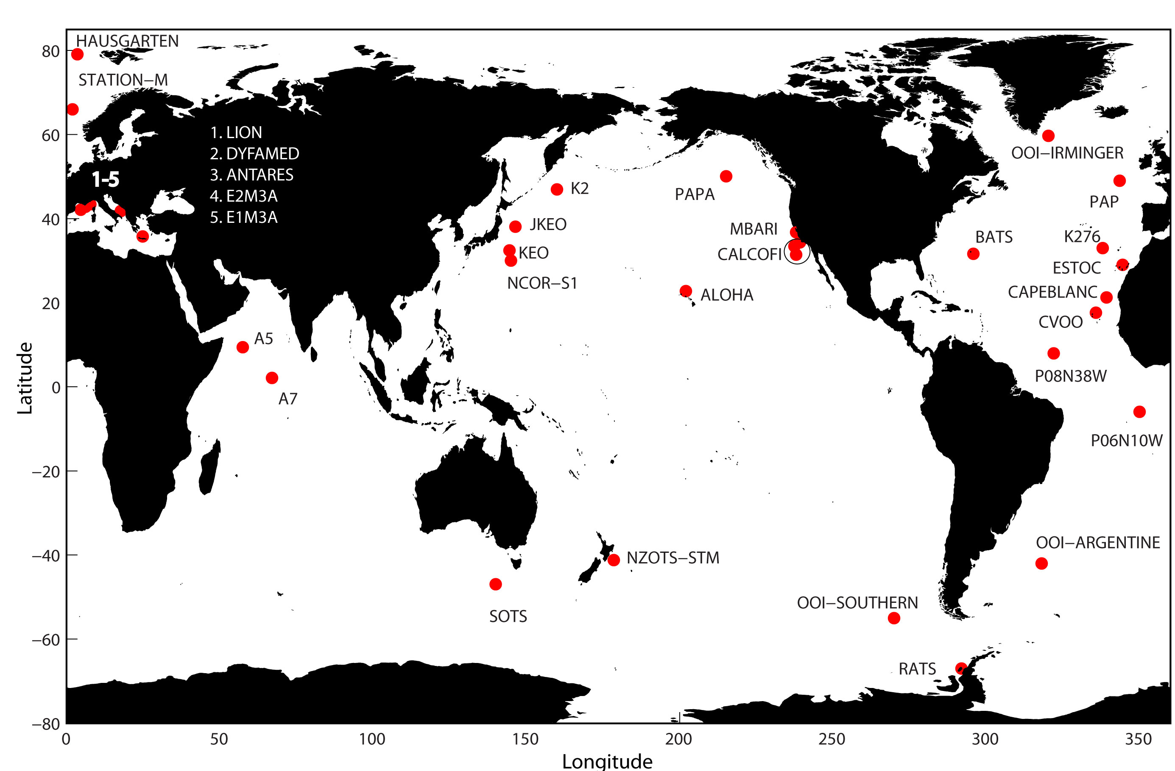
Relevance to sustained observations
Fixed-point observatories with a biogeochemical component (BGC-SOs) www.oceansites.org
Notes:
Just considering fixed point observatories: BATS, HOTS, PAP

Slide 14
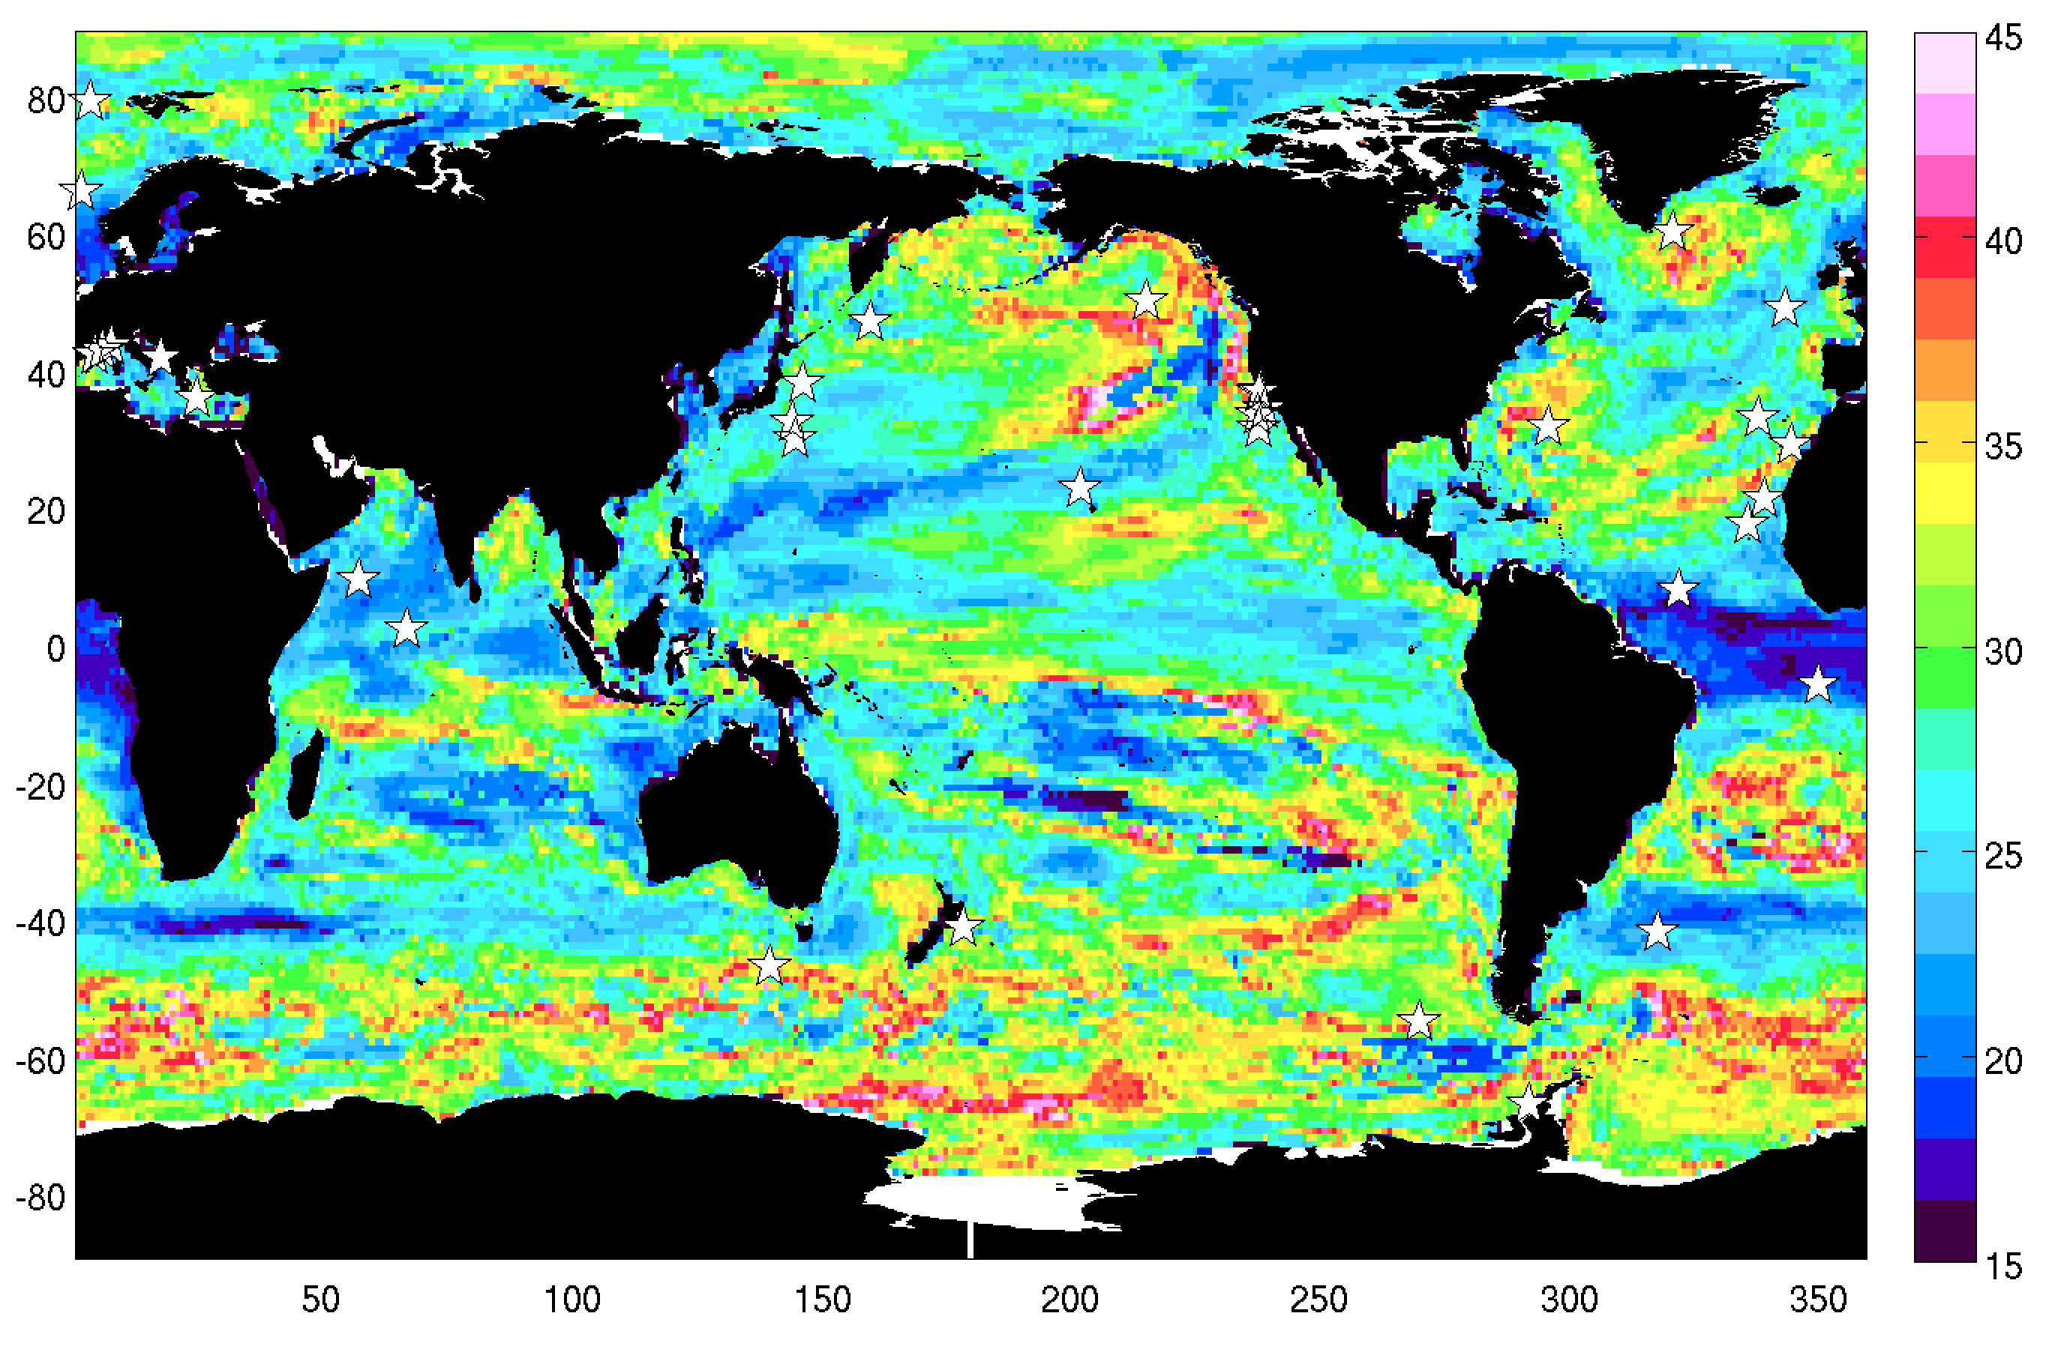
Relevance to sustained observations
years
Median n* (all 8 variables) and BGC-SOs

Slide 15
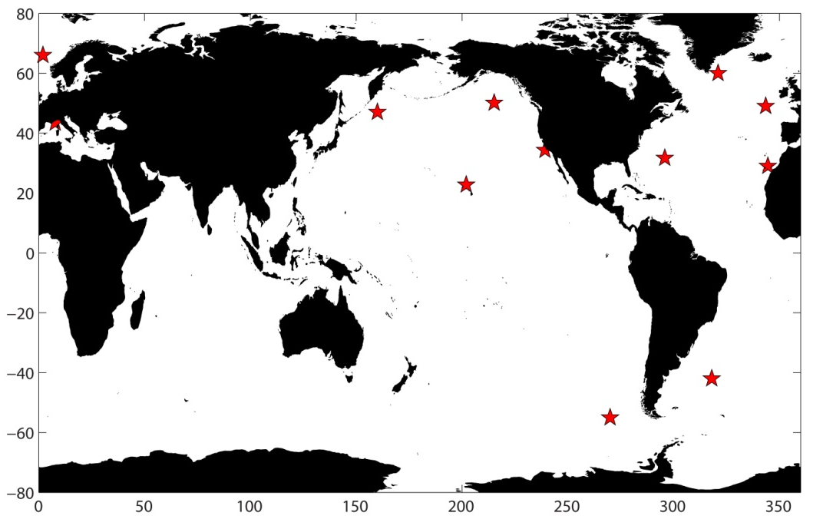
Relevance to sustained observations
Station | Median n* (years), all vars | Length of obs (years)
K2 | 23 | 6
HOT | 24 | 27
OOI-ARGENTINE | 24 | n/a
PAP | 25 | 14
MIKE | 25 | 27
DYFAMED | 26 | 25
ESTOC | 27 | 22
BATS | 28 | 27
CALCOFI | 29 | 67
PAPA | 33 | 12
OOI-IRMINGER | 34 | n/a
OOI-SOUTHERN | 36 | n/a
Notes:
HOT and MIKE detectable
At BATS, PP n.d. Dyfamed chl + export; ESTOC chl;
PAP min 9 (ph), max 30 (o2)

Slide 16
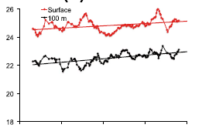
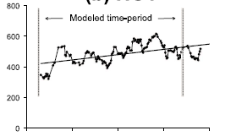
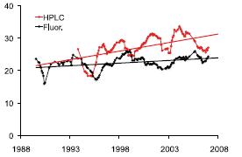
Relevance to sustained observations: example of ALOHA
20 years of data – are the observed trends due to climate change?
Our analysis suggests that for SST need 13 years, chl 29 years, and PP 26 years of data to distinguish genuine climate trend from natural variability
Saba et al. (2010), GBC
Notes:
More than 20 now
Suggests that the SST trend is indeed reflecting long-term climate change, but that the trends in NPP and chl may yet prove to be associated with natural variability and so should not yet be ascribed to climate change
Can use the kind of information we’ve generated in this analysis to figure out if can yet ascribe changes or not

Slide 17
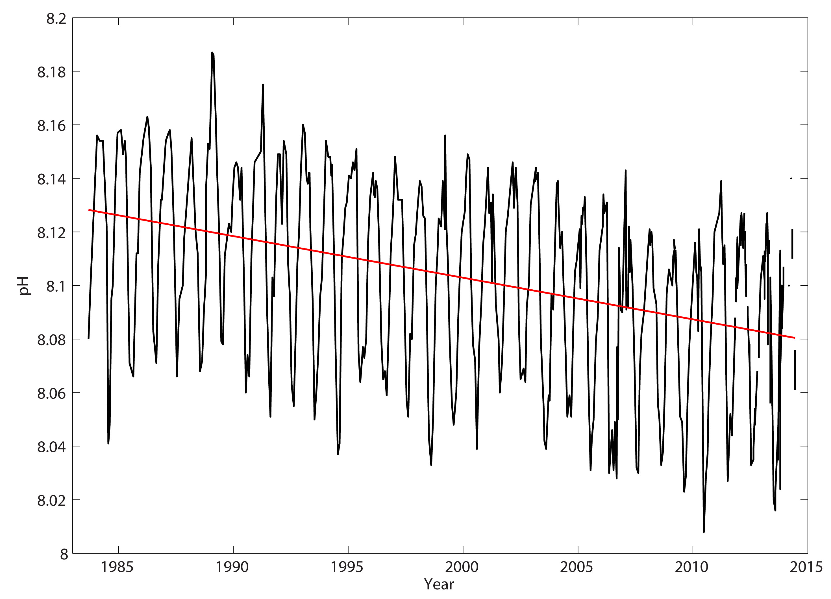
Relevance to sustained observations: example of BATS
pH at BATS; n* of 15 years
Notes:
30 years of data so much longer than n*, so this trend highly likely to be long-term trend

Slide 18
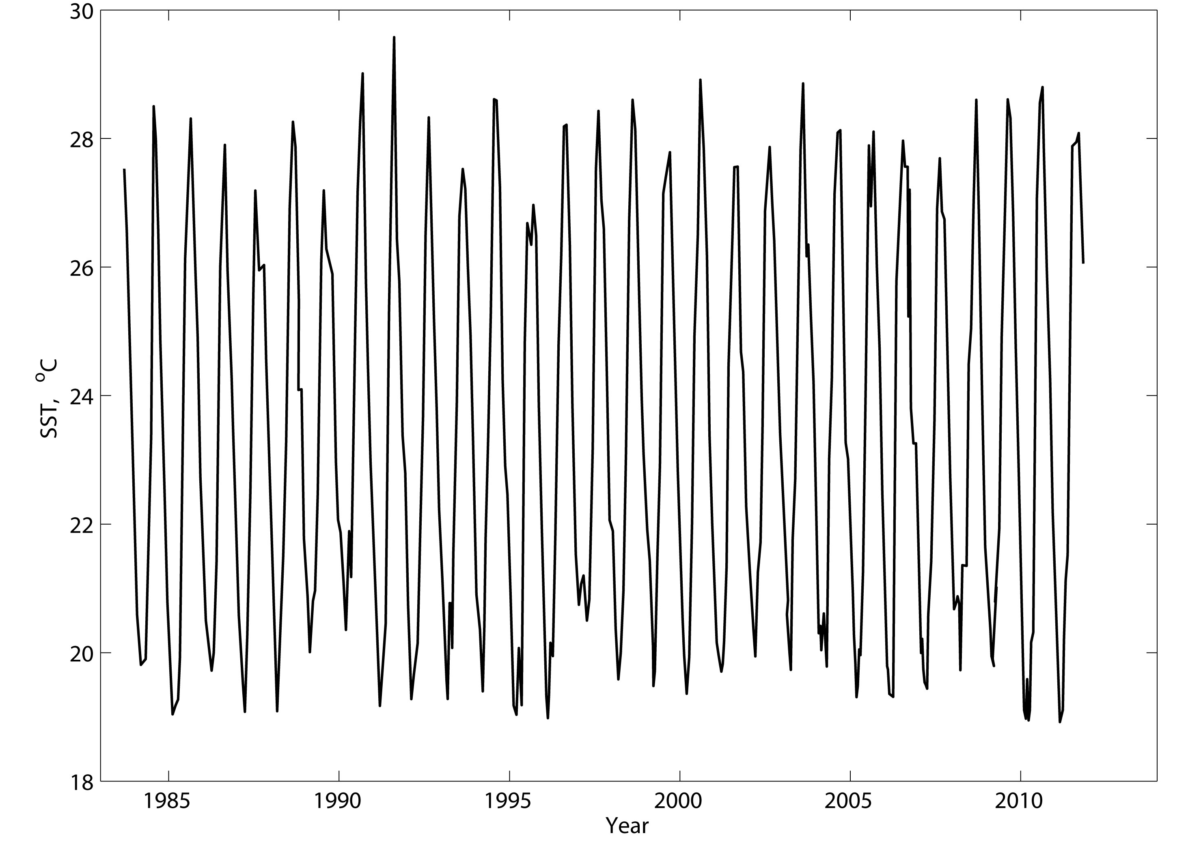
Relevance to sustained observations: example of BATS
SST at BATS; n* of 11.5 years

Slide 19
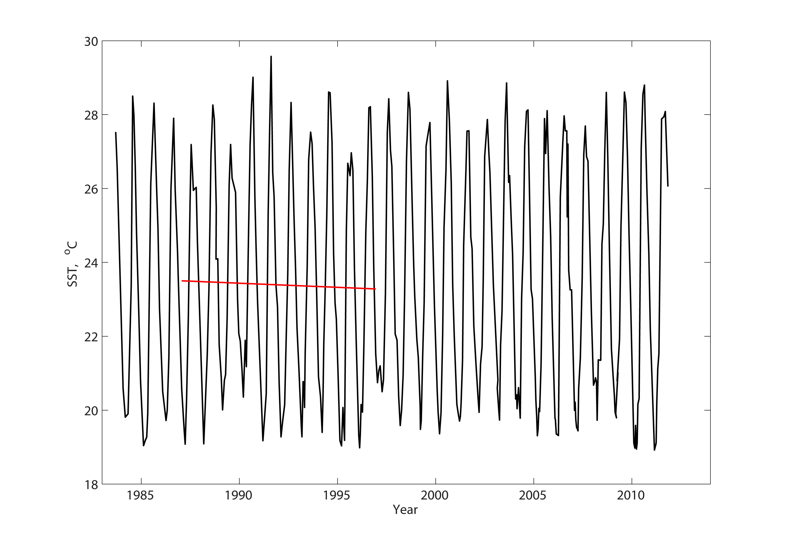
Relevance to sustained observations: example of BATS
10 year record: statistically significant trend
SST at BATS; n* of 11.5 years
Notes:
Take a 10 year chunk : stat sig trend. Our analysis suggests this prob not due to long-term trend but rather natural variability

Slide 20
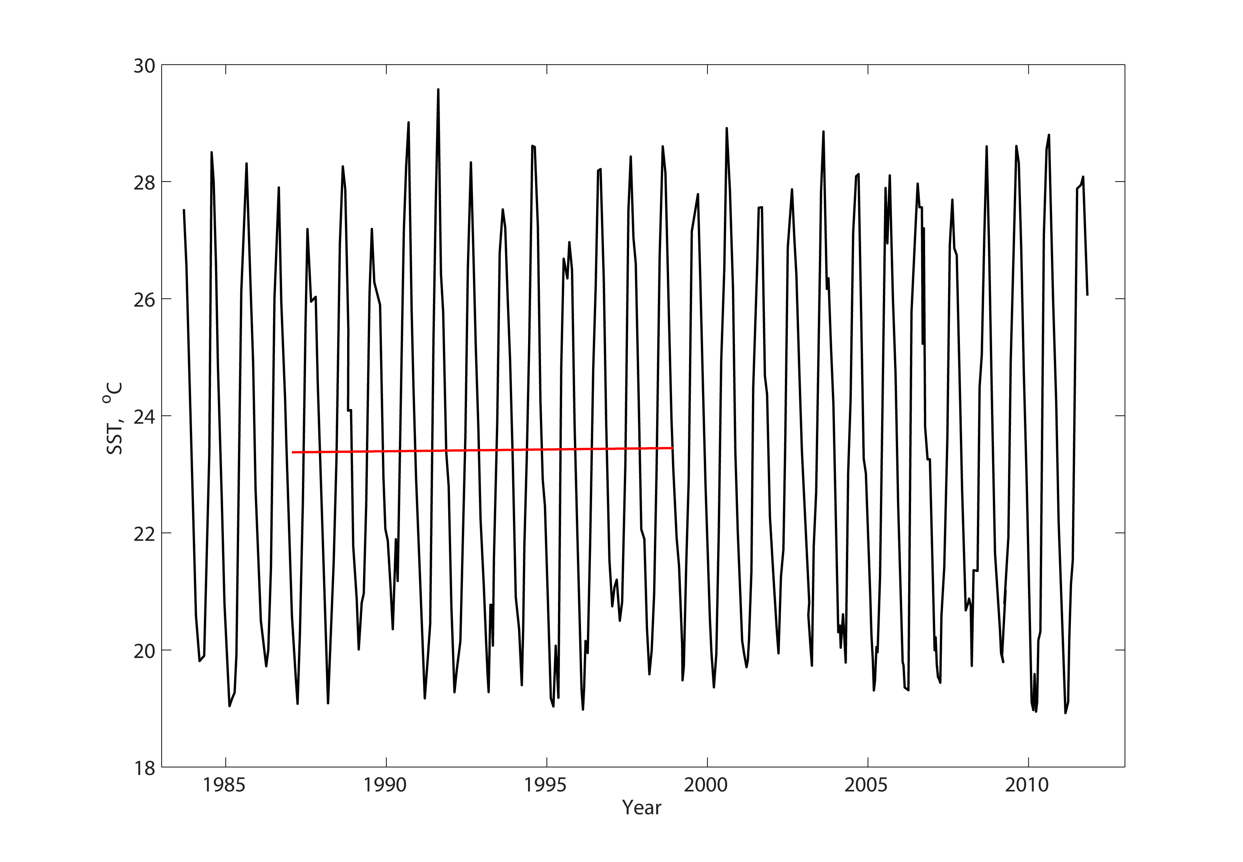
Relevance to sustained observations: example of BATS
12 year record: no statistically significant trend
SST at BATS; n* of 11.5 years
Notes:
Take a 12 year chunk : and consist with our predictions of n* the stat sig trend disappears i.e. if you have more than 11 years of data then you can reliably distinguish a long-term trend (if there is one) from natural variabillity. This dataset is substantially longer than n* so that if a long-term trend were present, it could be reliably detected. Suggests that anthropogenic forcing in SST at BATS not yet distinguishable from natural var

Slide 21
Summary 1
Analysis provides an estimate of timescales needed to distinguish climate change-driven trends from natural variability
Useful for assessing current datasets
Some datasets, some variables, have enough data to detect climate trend (if there is one)
But many don’t
Also useful for planning future time series observations

Slide 22
BGC-SOs and representativeness
It’s unfeasible to fill the ocean with in situ observing stations
So how representative of broader regions are current BGC-SOs? (i.e. what is their ‘footprint’?)
Here, ‘footprint’ is where mean and variability of time series are similar

Slide 23
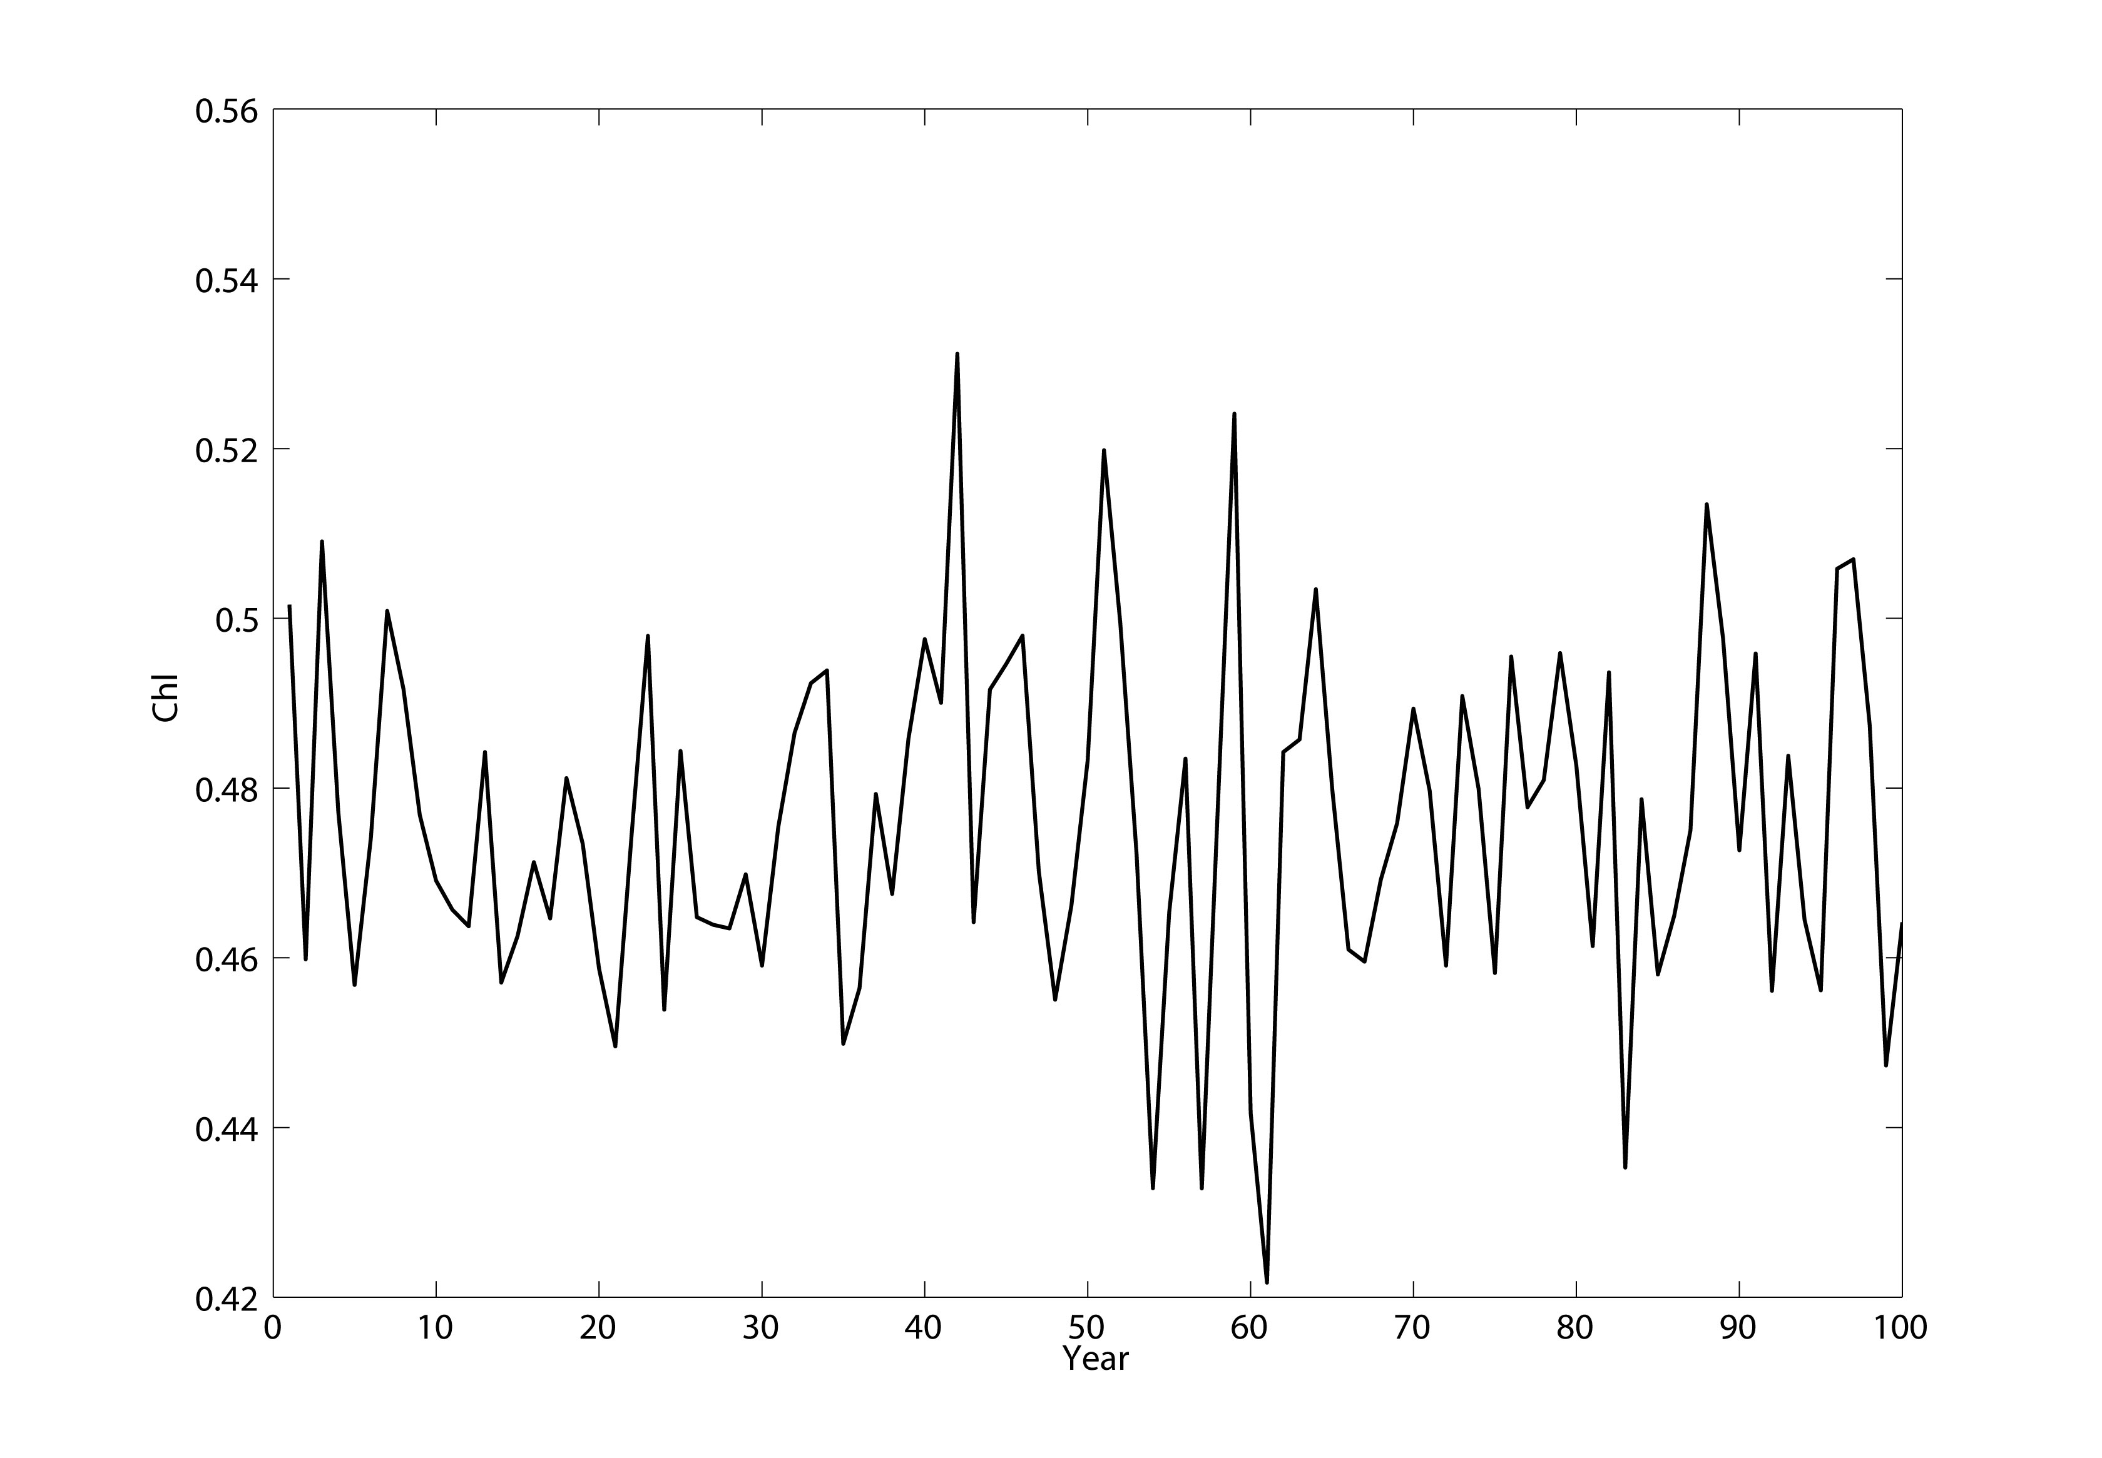
Method for estimating footprint
Take control run of data at a BGC-SO
Here chlorophyll concentration at PAP site
Notes:
Crude approach but...

Slide 24
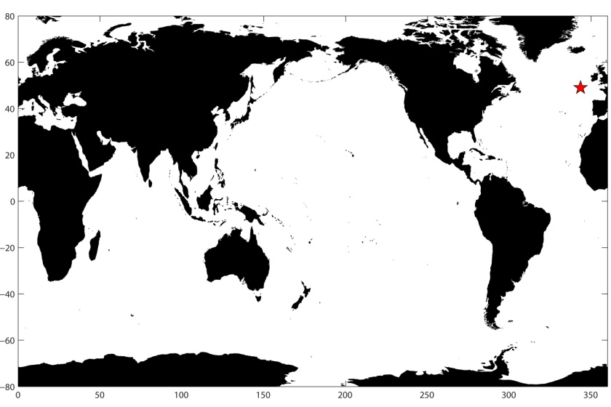
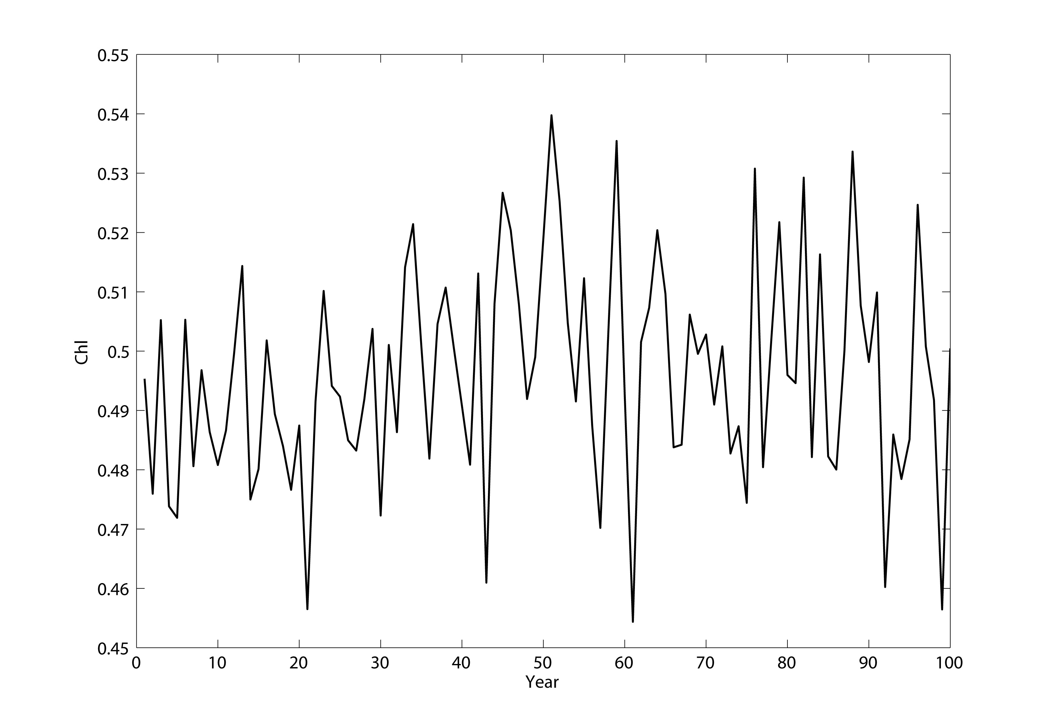
Method for estimating footprint
R=0.68, p<0.05
Correlate PAP site time series with every other pixel
Notes:
Red star is PAP, blue is 2nd time series

Slide 25
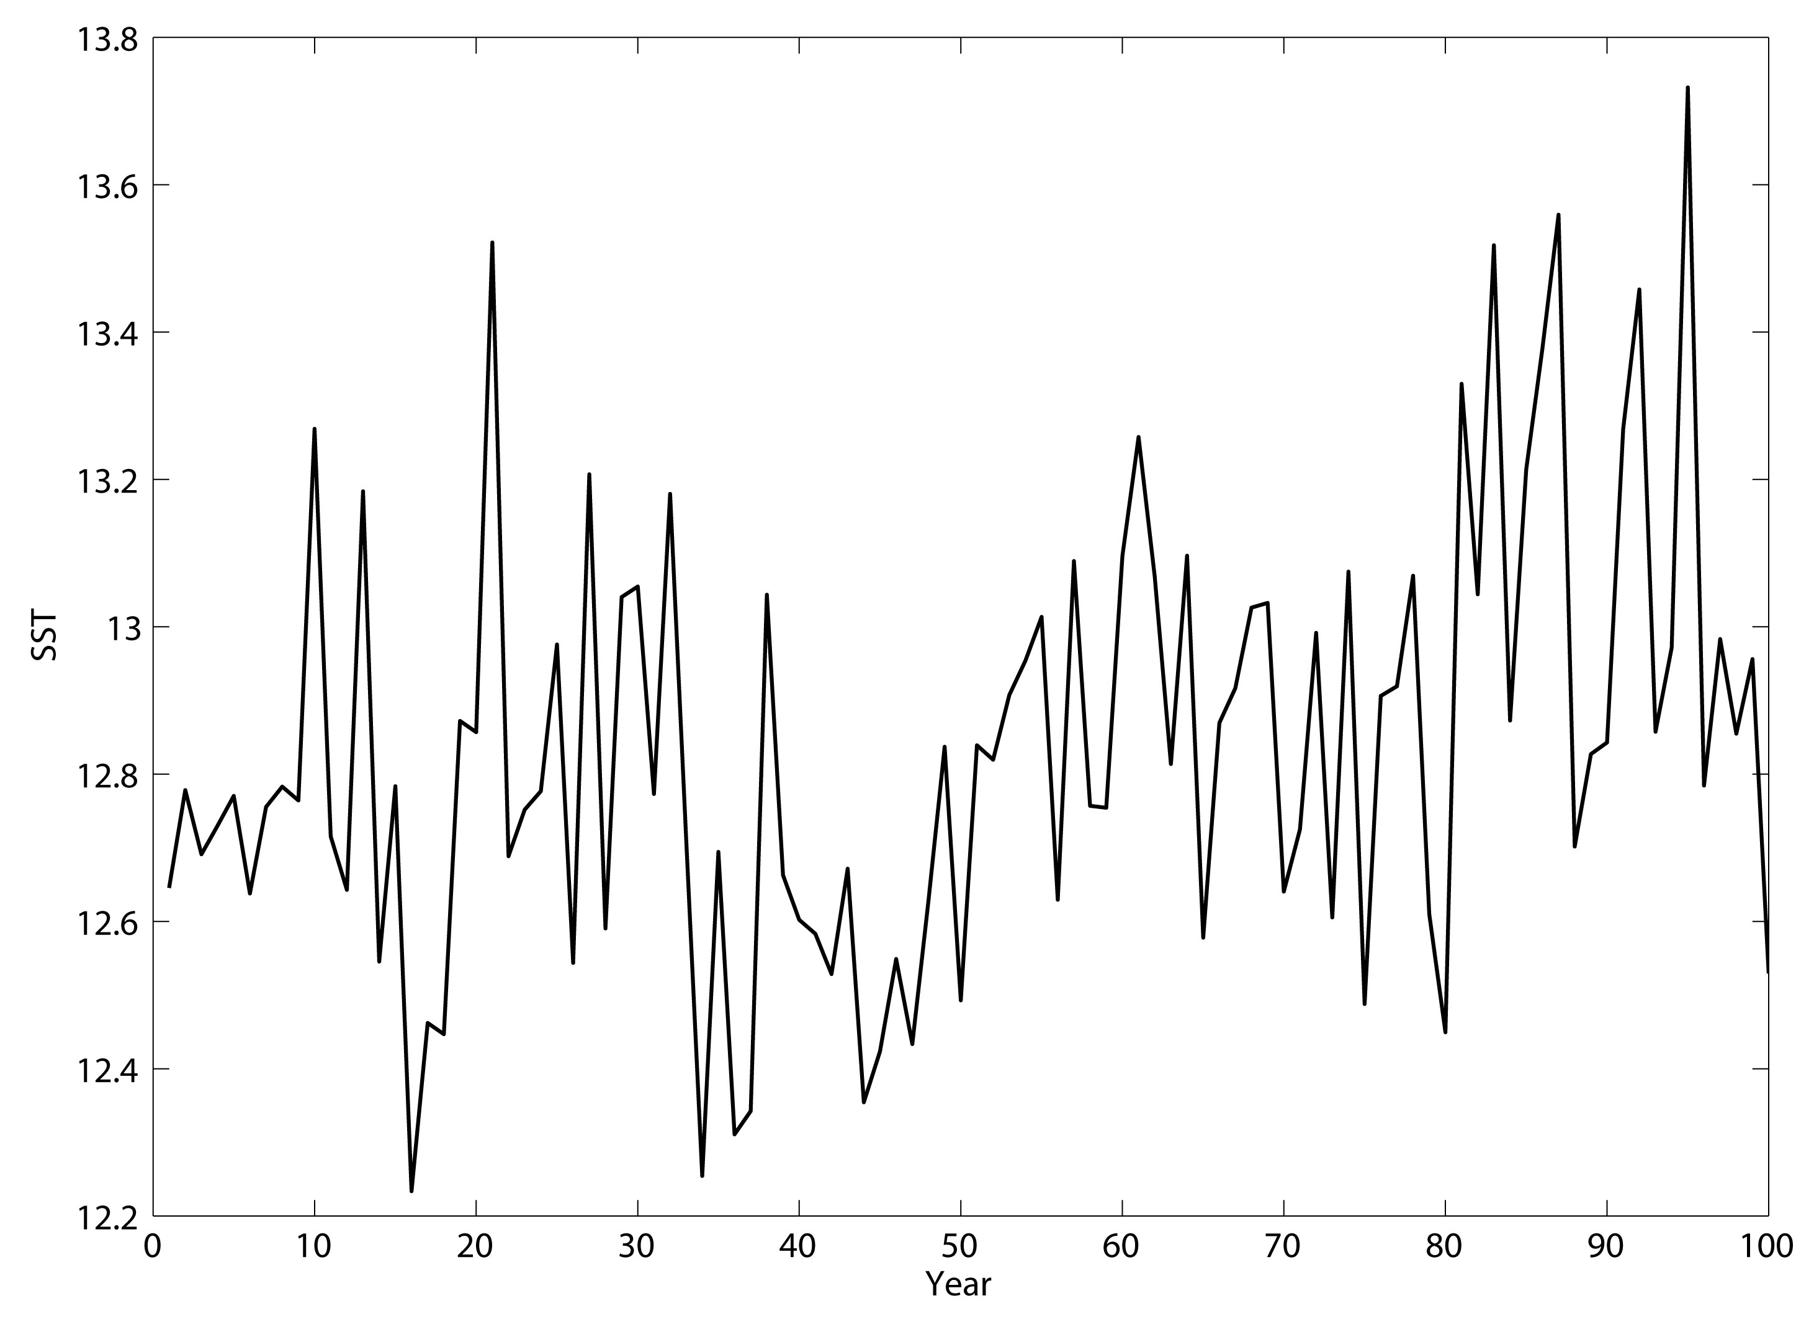
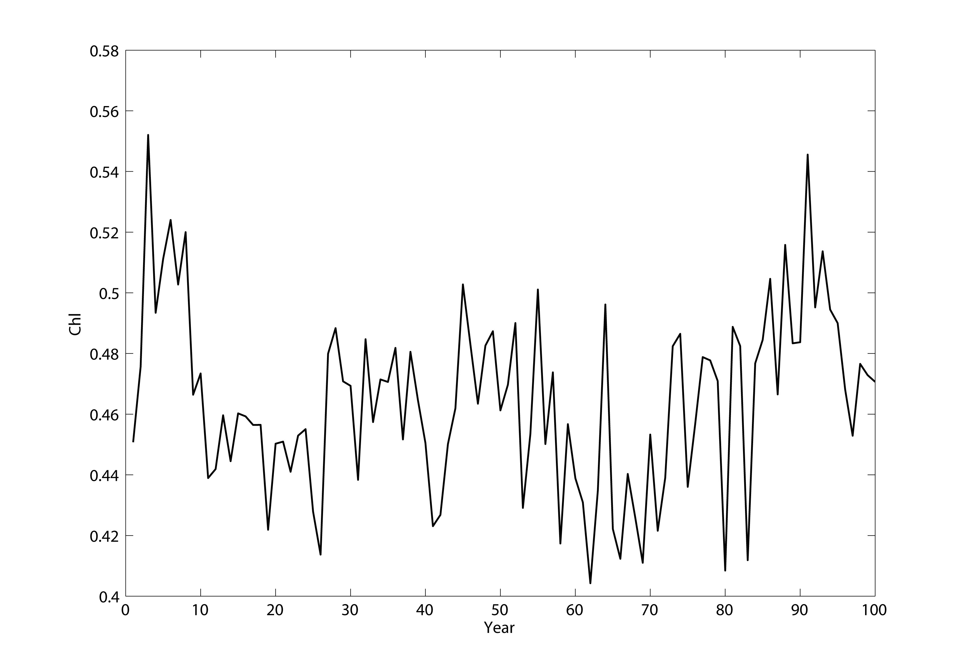
Method for estimating footprint
R=0.17, p>0.05
Correlate PAP site time series with every other pixel
Notes:
Further away you get, R gets smaller until no longer stat sig

Slide 26
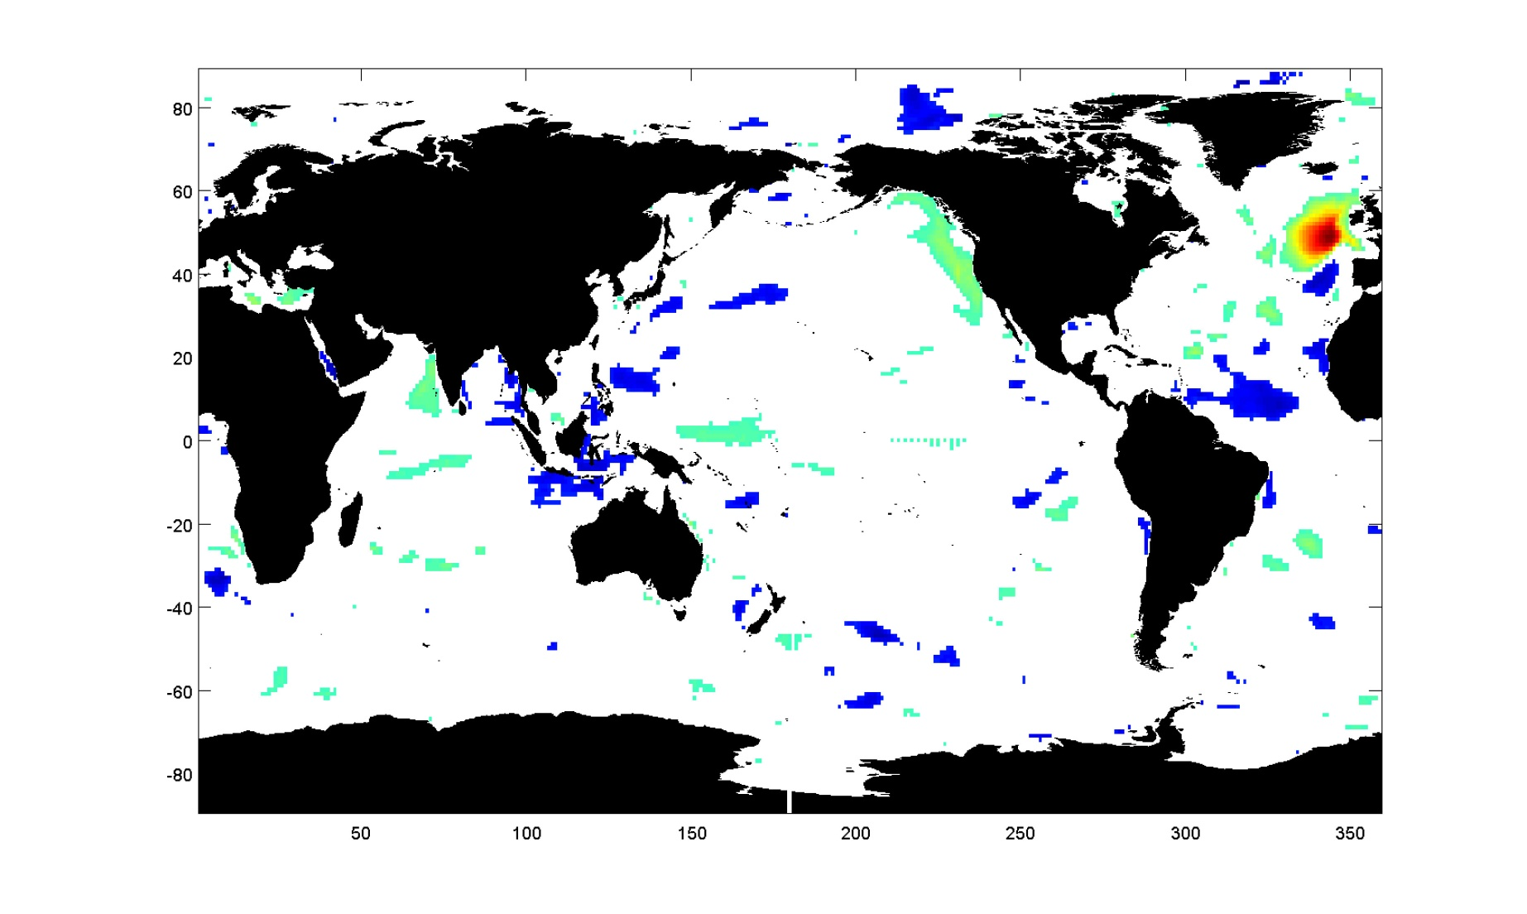
Method for estimating footprint
Correlation coefficient for PAP site time series with every other pixel (p>0.05 removed) and where mean is within 2 s.d.
Notes:
Matching variability AND mean

Slide 27
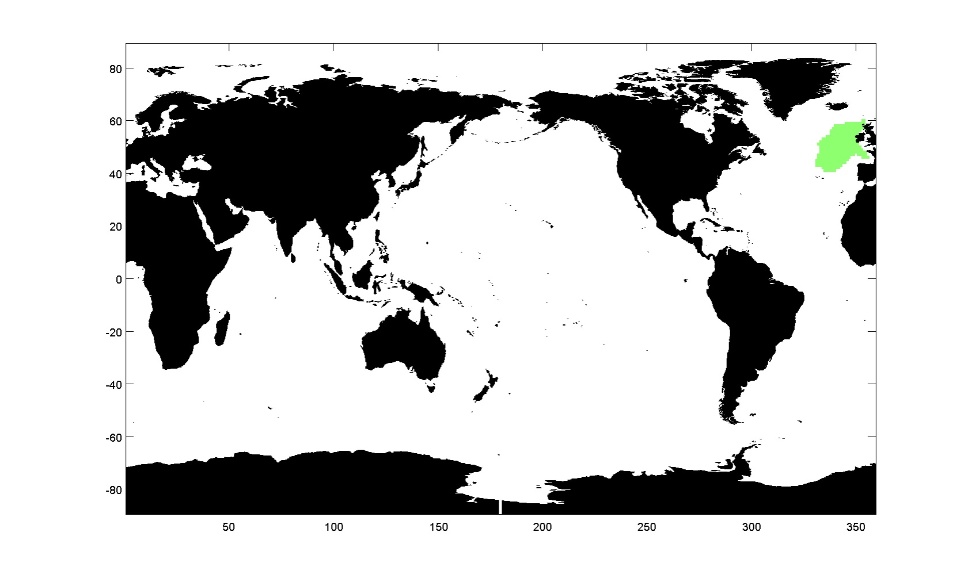
Method for estimating footprint
Retain only areas that are contiguous with the time series station.....repeat for all 8 models

Slide 28
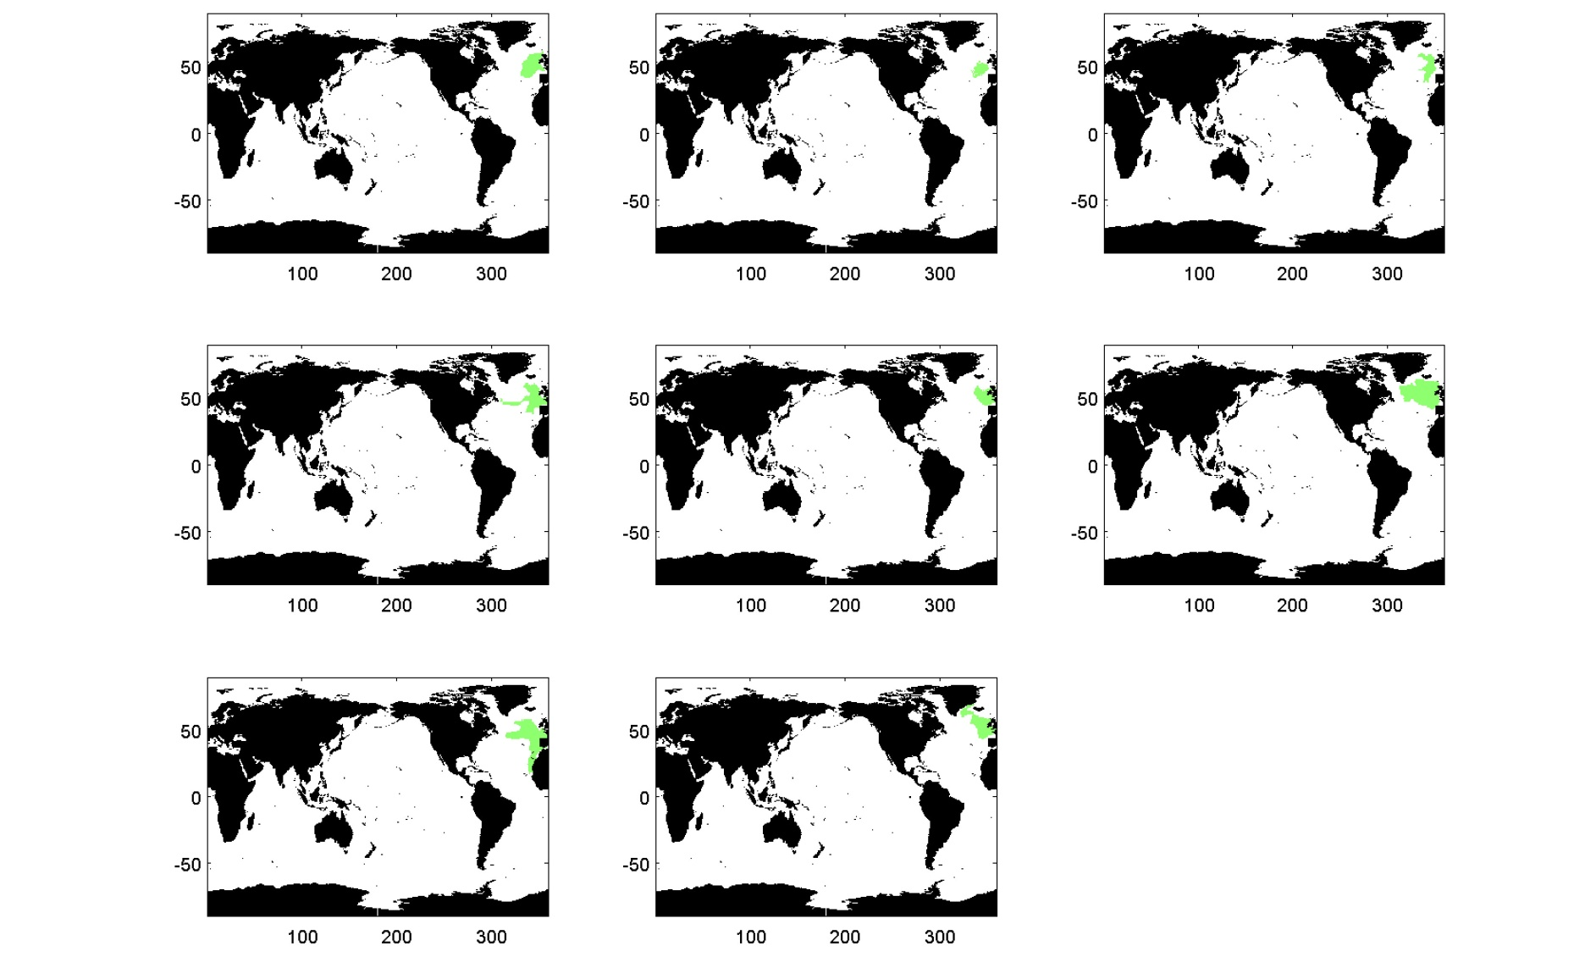
Method for estimating footprint
Repeat for all 8 models.....select only the region where at least half of the models overlap

Slide 29
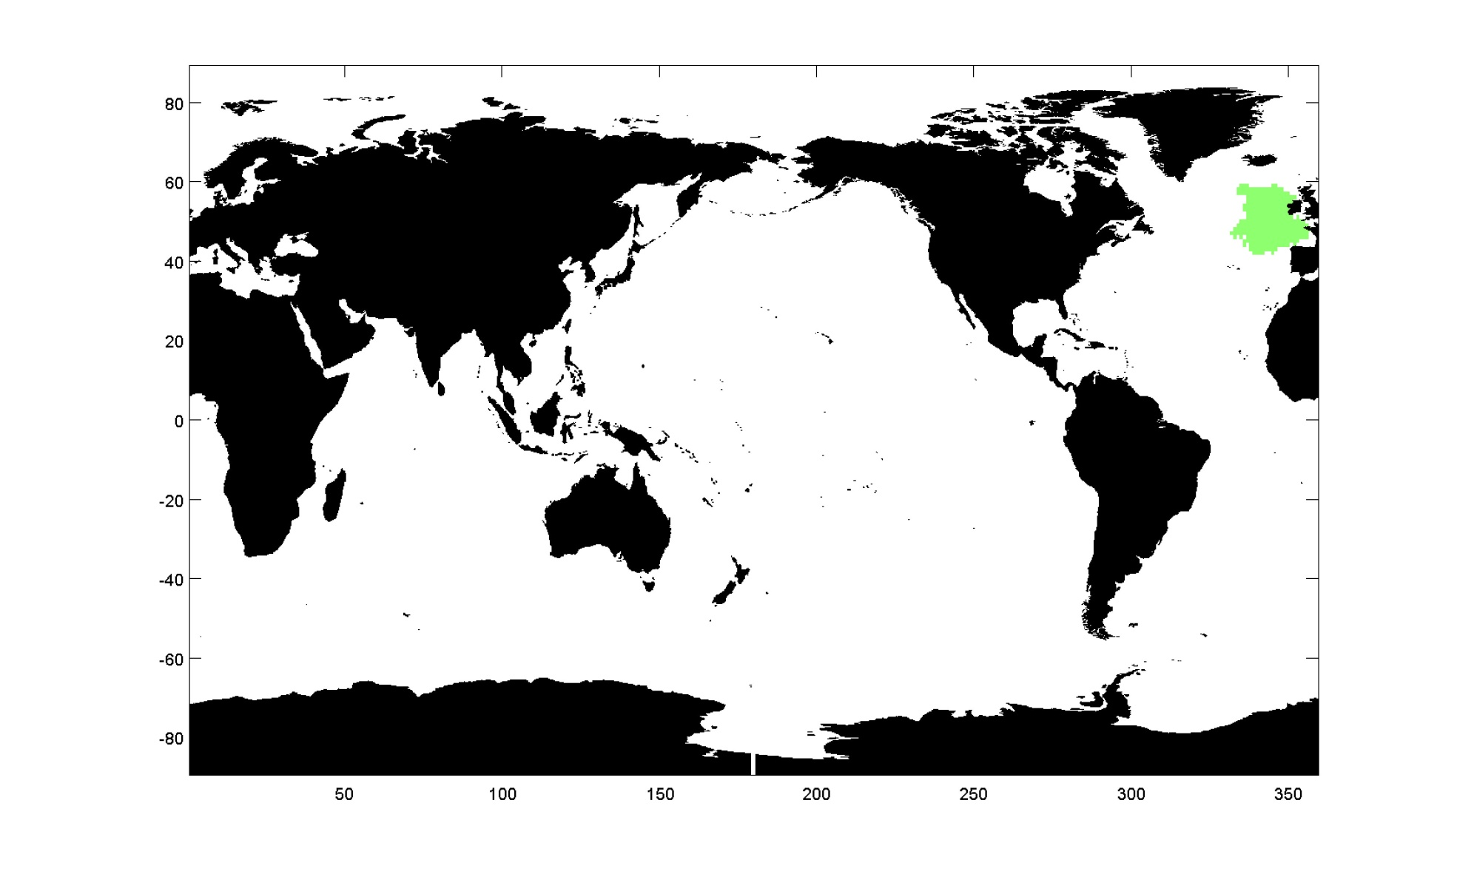
Method for estimating footprint
Select only the region where at least half of the models overlap...repeat for all BGC-SOs

Slide 30
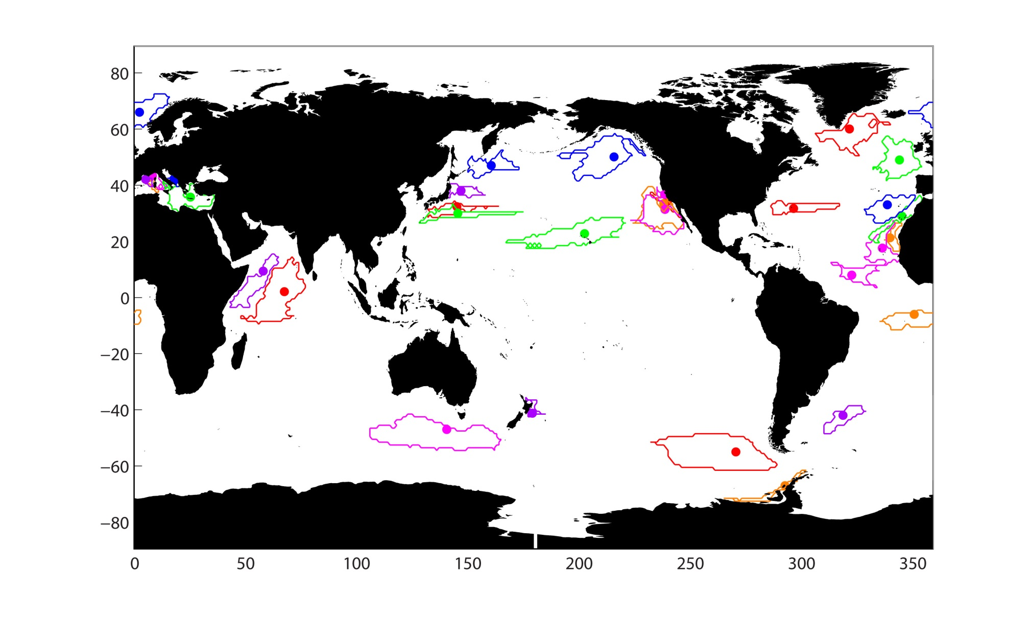
Footprints for chlorophyll
Regions for which BGC-SOs are ‘representative’ for chlorophyll

Slide 31
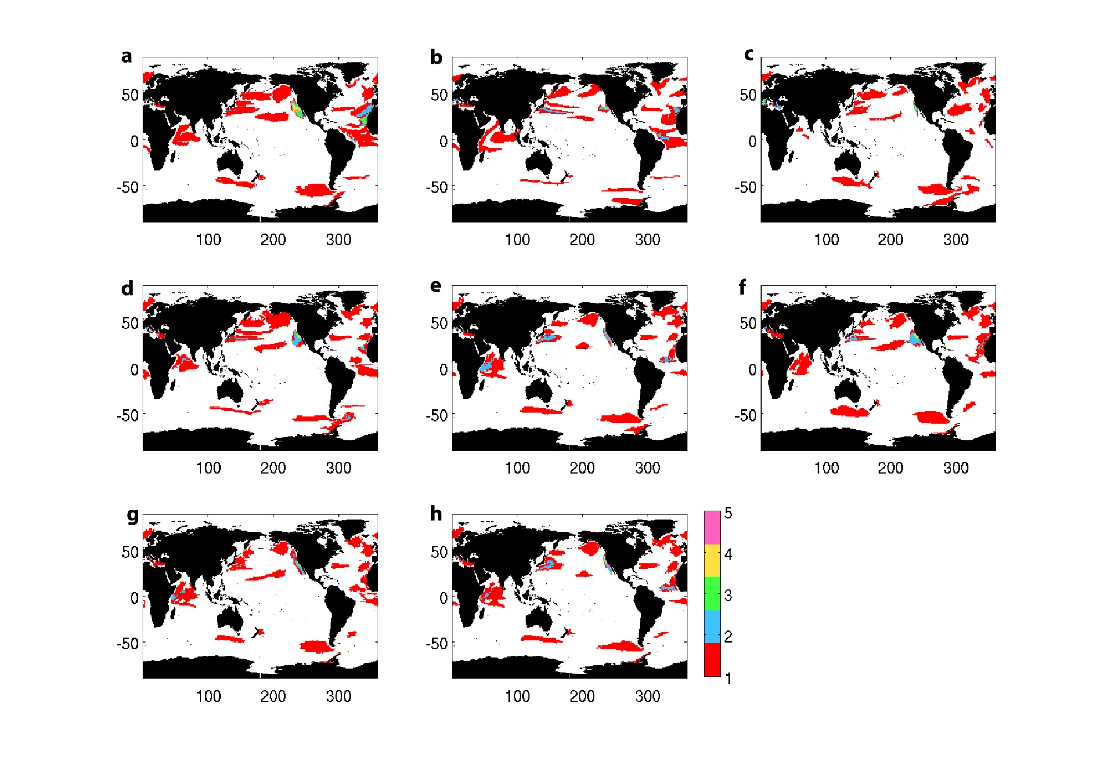
Footprints for time series stations
pH
SST
Oxygen
Nitrate
Non-diatom PP
Chlorophyll
Export
PP
Number of BGC-SOs that ‘represent’ each region

Slide 32
Coverage by fixed point observatories
Variable | % of ocean covered by fixed point observatories
pH | 15
SST | 13
Nitrate | 13
Chlorophyll | 12
PP | 11
Export | 11
Non-diatom PP | 11
Oxygen | 9
Spatial scales of ‘representativeness’ are largest for pH
Notes:
Other sources of data – surface T, chl by satellite, Argo, bio-Argo etc.

Slide 33
Size of footprint for chl
Footprint (10⁶ km²). Black contour marks where footprint is large (> 7 x 10⁶ km²) and n* is short (< 35 years)
Notes:
Optimal location where footprint large and n* short (ignoring logistics)

Slide 34
Summary 2
Analysis provides an estimate of the spatial scales over which fixed point observatories are ‘representative’ of surrounding areas
Useful for assessing current datasets
Which cover in total < 15 % of ocean area
Southern Hemisphere particularly poorly represented
Also useful for planning future time series observations
Notes:
All this based on model results….

Slide 35
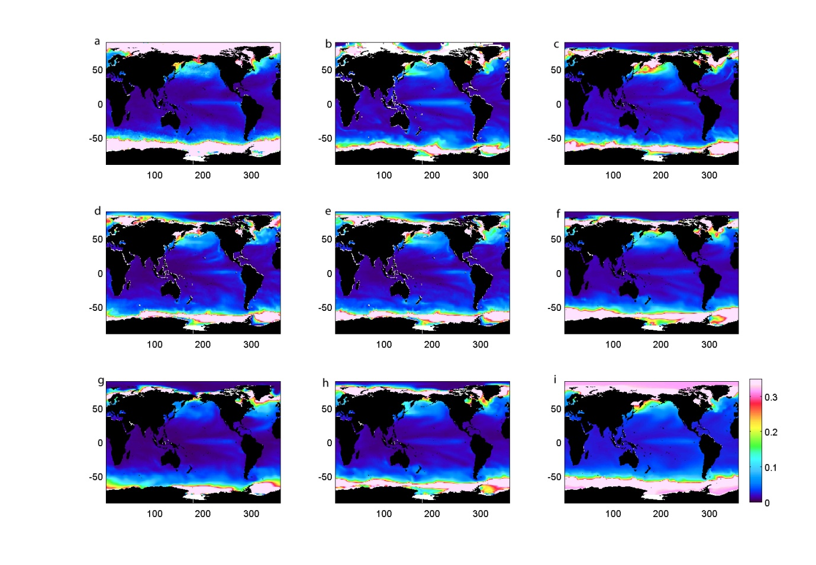
Limitations
Models need to be representing natural variability well
Coefficient of variation in SST for observations and all 8 models
Notes:
Only 2 vars we can test at right space and time scales: chl and T
Can you guess which is obs?
Overall, the models represent the natural variability in SST very well, although it is underestimated in the Arctic. For chlorophyll, observed variability is generally larger than modelled in the coastal and polar regions

Slide 36
Limitations
Models need to be representing natural variability well
“representative” = mean + variability
Repeat testing for statistical significance
Linear trend
Coarse resolution of models (1°)

Slide 37
Limitations
Models typically found to underestimate observed variability
Coarse resolution of models (1°) – not resolving (sub)mesoscale variability
→ ‘Best case’ scenario
Footprints are likely to be smaller and n* longer than models suggest
Notes:
Return to questions I posed at the beginning

Slide 38
Questions
Can climate change signals be detected more rapidly in other biogeochemical variables (other than PP)?
How long for, and where, should we make observations if we want to detect climate change effects?
And how does all this relate to our current observing capabilities?

Slide 39
Questions
Can climate change signals be detected more rapidly in other biogeochemical variables?
→ pH and SST : yes (14-16 years global average)
→ oxygen, nitrate, export, non-diatoms etc. : no (26-33 years global average)

Slide 40
Questions
How long for, and where, should we make observations if we want to detect climate change effects?
→ equatorial Atlantic, Benguela and Arabian Sea have consistently short n*
→ parts of Arabian Sea also has large footprints

Slide 41
Questions
And how does all this relate to our current observing capabilities?
→ In some cases, time series should be long enough to detect trends (if they exist), e.g. export flux at ALOHA
→ For most time series stations, not yet long enough to detect trends

Slide 42
Summary
Current BGC-SO network is not adequate for trend detection
IF you want to detect change in every variable, every where
(assumption that we’re only interested in CC, which isn’t necessarily the case)
Provides a basis for objective assessment (space/time scales) of existing and future planned SOs
Also, note that fixed point BGC-SOs only here
Future work – what is the minimum sampling network to capture CC effects? How many, where, how long?
Henson et al. (2016), Global Change Biology
Notes:
But some variables, in some places are OK
Satellites, Bio-argo, Argo, gliders etc.
Provides a basis for objective assessment of existing and future planned SOs

